Slide 1
AUDIO to MIDI CONVERTER with SYNTHESIZER
Murtaza Dhuliawala (1004024)
Sanjay Khatwani (1004043)
Hirak Modi (1004054)
Project Guide:
Dr. Archana B. Patankar

Slide 2
Music Information Retrieval
Aims at extending the understanding and usefulness of music data, through the research, development and application of computational approaches and tools.
Retrieving information from music
Includes melody extraction and retrieval

Slide 3
Digital Signal Processing
Manipulate, retrieve the information in the signal
Signals are converted from time or space domain to the frequency domain usually through the Fourier transform.
The Fourier transform converts the signal information to a magnitude and phase component of each frequency.
Often the Fourier transform is converted to the power spectrum, which is the magnitude of each frequency component squared.

Slide 4
Audio
Audio is sound within the acoustic range available to humans.
In computers audio is stored as a sequence of digital signals.
Usually compressed
Advantage : Good quality of music
Disavantage : Huge (10MB/min)

Slide 5
MIDI
Musical Instrument Digital Interface
Only messages are transmitted not actual sound
Note and the intensity specified in the message
Advantage : Tiny (10k/min)
Disadvantage : Lower quality

Slide 6
Scope of our project
Record Audio from an instrument
Convert it into MIDI file
Give the MIDI file to the synthesizer which will produce the desired output

Slide 7
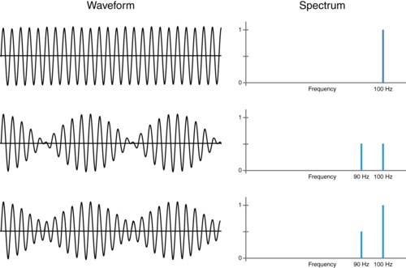
Roadmap
Software Development using C++/C#.
Library will be used: VST Audio Plug-ins SDK/VST.net
FFT related algorithm will be used for conversion to MIDI.
Virtual Studio Technology instrument (VSTi) for synthesizer plugin.

Slide 8
Usefulness
Great tool for Musicians.
User can play any instrument without knowing how to play it.
VSTi can be used with any Digital Audio Workstation.

Slide 9
Future Scope of Expansion
Note Prediction.
Music genre recognition.
Auto accompaniment system.
Application in mobile devices.
Voice Recognition.

Slide 10
References
A Generative Model for Music Transcription: A. Taylan Cemgil, Member, IEEE, Hilbert J. Kappen, Senior Member, IEEE, and David Barber
Automated Classification of Piano–Guitar Notes: Dimitrios Fragoulis, Member, IEEE, Constantin Papaodysseus, Mihalis Exarhos, George Roussopoulos, Thanasis Panagopoulos, and Dimitrios Kamarotos
MIDI Implementation of a Kulintang Modal Synthesizer using the VST2.4 Standard: Ann Franchesca B. Laguna, Nicanor Marco P. Valdez and Rowena Cristina L. Guevara
Recognition of piano notes with the aid of FRM filters: Say Wei Foo, Edwin, Wei Thai Lee
Audio coding for conversion to MIDI: N. J. Sieger and A. H. Tewfik
Frequency to MIDI Converter for Musical Instrument Microphone System: Runfeng Yang, Member of IEEE, Jianyong Bian, Liping Xiong
Polyphonic Audio Key Finding Using the Spiral Array CEG Algorithm: Ching-Hua Chuan and Elaine Chew

Slide 11
Thank You!

